Slide 1
FINMARK
MO-IT162 Terminal Assessment
ML Solution
FinMark: From Raw Data to Customer Insights
BSIT-H3101 • Group 6
MO-IT162 • Math for Machine Learning: Linear Algebra
Danica Mae Tugare | Christian Cristobal | Pg Amir Nur Mohammad Urbano

Slide 2
01 • PROJECT CONTEXT
What did we set out to understand?
FinMark brings together three views of customer activity.
CUSTOMERS
TRANSACTIONS
SOCIAL ENGAGEMENT
Who are they?
Age, gender, location,
income and signup date
What do they buy?
Date, amount, product
category and payment
How do they interact?
Platform, interaction type,
date and sentiment
Goal: prepare reliable data, explore patterns, and identify useful signals for future machine learning.
FINMARK | MO-IT162 • MATH FOR MACHINE LEARNING: LINEAR ALGEBRA
02 | Speaker 1

Slide 3
01 • DATA FOUNDATION
Three datasets, one connected customer view
3,200
6
CustomerID
raw rows in each dataset
original columns per dataset
shared linking key
• Demographics: CustomerID, Age, Gender, Location, IncomeLevel, SignupDate.
• Transactions: CustomerID, TransactionID, TransactionDate, Amount, ProductCategory, PaymentMethod.
• Social interactions: CustomerID, InteractionID, InteractionDate, Platform, InteractionType, Sentiment.
FINMARK | MO-IT162 • MATH FOR MACHINE LEARNING: LINEAR ALGEBRA
03 | Speaker 1

Slide 4
01 • MILESTONE 1: PREPROCESSING
The raw data had quality issues
Duplicate records
Missing values
Special / inconsistent values
• Exact duplicate rows: 177 demographics, 185 transactions, 180 social.
• Non-identical conflicting IDs: 23 demographics, 15 transactions, 20 social.
• Age 291; IncomeLevel 303.
• Amount 304; ProductCategory 299.
• Platform 311; Sentiment 329.
• Age included “Unknown”, -1 and 150.
• Amount included “Free” labels and signed negatives requiring separate review.
• Dates mixed YYYY-MM-DD and DD/MM/YYYY.
Key lesson: duplicates were not limited to identical rows. Business identifiers also had to be checked.
FINMARK | MO-IT162 • MATH FOR MACHINE LEARNING: LINEAR ALGEBRA
04 | Speaker 1

Slide 5
01 • PREPROCESSING WORKFLOW
How we cleaned the datasets
1
Deduplicate
Remove exact duplicates; audit business-key conflicts; retain verified original-source records.
2
Validate
Convert Age and Amount to numeric; treat impossible ages as invalid and preserve signed negatives for review.
3
Impute / label
Use median for missing numerical values; use “Unknown” for missing categorical values.
4
Standardize
Parse mixed date formats, trim text whitespace, and store IDs as strings.
5
Preserve context
Keep transaction flags for free labels, imputed amounts, and possible negative/refund cases.
Tools: Python and Pandas for cleaning and data manipulation.
FINMARK | MO-IT162 • MATH FOR MACHINE LEARNING: LINEAR ALGEBRA
05 | Speaker 1

Slide 6
02 • CLEANED DATA
Cleaning results and an important data note
3,000
0
0
rows per dataset after deduplication
duplicate business IDs
missing fields in demographics & social
Transaction Amount requires a careful distinction:
• The finalized transactions CSV contains 3,000 rows, with 29 Amount values unresolved for records originally labeled “Free”.
• The final analysis excludes these 29 unresolved labels from numeric calculations; 2,971 numeric Amount values are analyzed.
• Audit flags preserve 34 signed negatives, 282 source-missing imputations, 29 genuine zeros, and 29 unresolved Free labels.
We report the actual CSV and notebook behavior here rather than describing every Amount field as fully numeric.
FINMARK | MO-IT162 • MATH FOR MACHINE LEARNING: LINEAR ALGEBRA
06 | Speaker 2

Slide 7
02 • MILESTONE 2: METHODS
From cleaned tables to analysis
• Pandas: load, clean, merge and aggregate records by CustomerID.
• NumPy: calculate descriptive statistics, quartiles, variance and correlation values.
• Matplotlib and Seaborn: create histograms, bar charts, boxplots, scatter plots, line charts and heatmaps.
• The analysis examines distributions, category balance, customer-level relationships, time trends and possible anomalies.
LINEAR ALGEBRA CONNECTION
Before many ML algorithms can use the data, records must be represented as numerical features. Categorical variables need encoding, and numerical features may need scaling. Correlation matrices help inspect linear relationships between numeric variables.
No predictive model was trained in these milestones. This work prepares and investigates the data for later modeling.
FINMARK | MO-IT162 • MATH FOR MACHINE LEARNING: LINEAR ALGEBRA
07 | Speaker 2

Slide 8
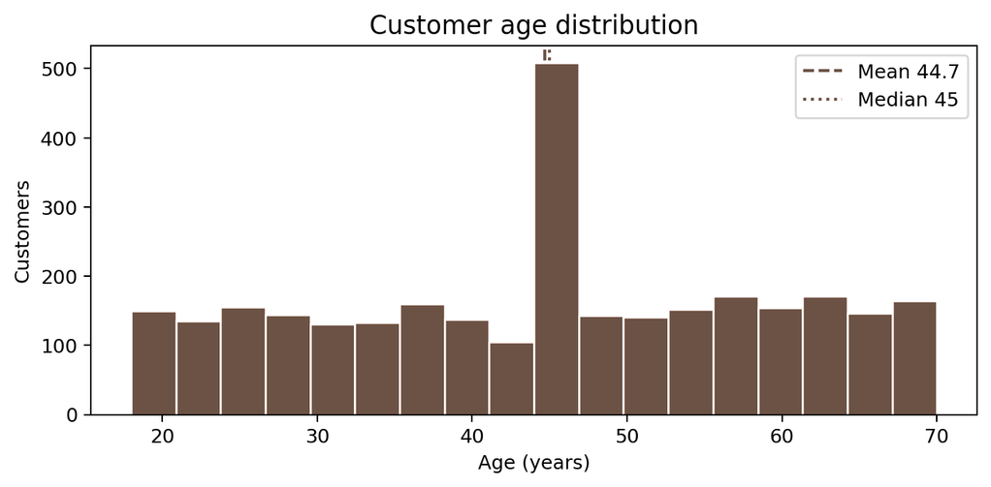
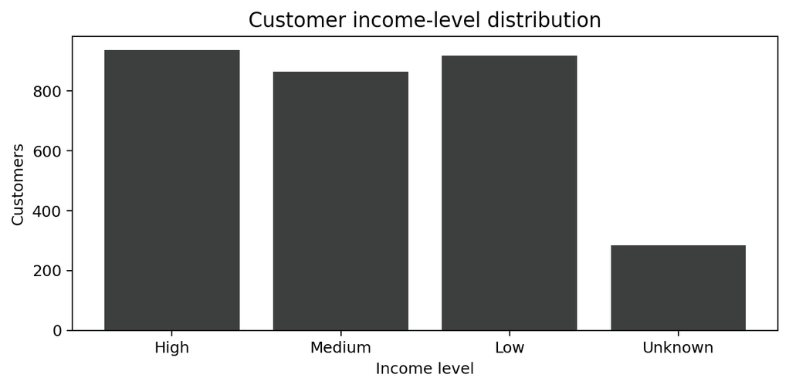
02 • DISTRIBUTIONS
Who is represented in the customer data?
Average age: 44.680 years • Median: 45 • SD: 14.437 • Range: 18–70
Income categories are broadly represented; “Unknown” records reflect missing source information, not a real income segment.
FINMARK | MO-IT162 • MATH FOR MACHINE LEARNING: LINEAR ALGEBRA
08 | Speaker 2

Slide 9
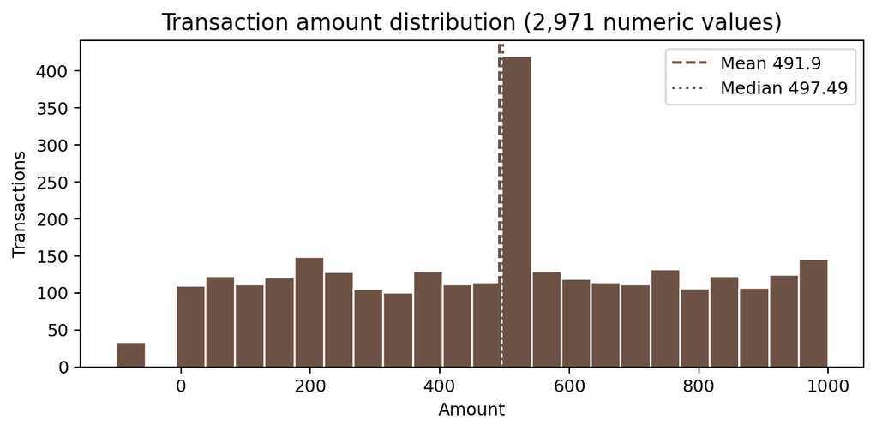
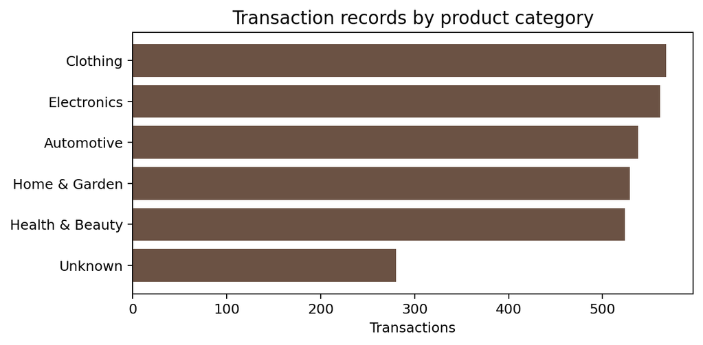
02 • TRANSACTION PATTERNS
What are customers buying and spending?
491.931
497.49
2,971
mean amount • SD 283.658
median transaction amount
numeric amounts analyzed
FINMARK | MO-IT162 • MATH FOR MACHINE LEARNING: LINEAR ALGEBRA
09 | Speaker 2

Slide 10
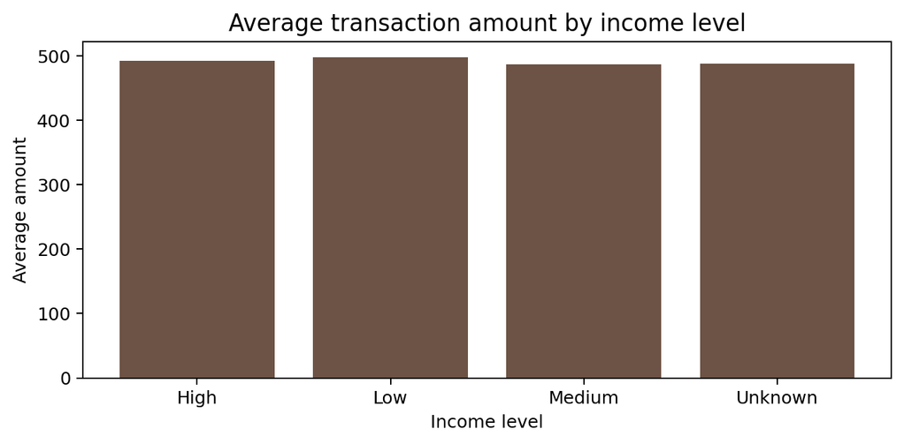
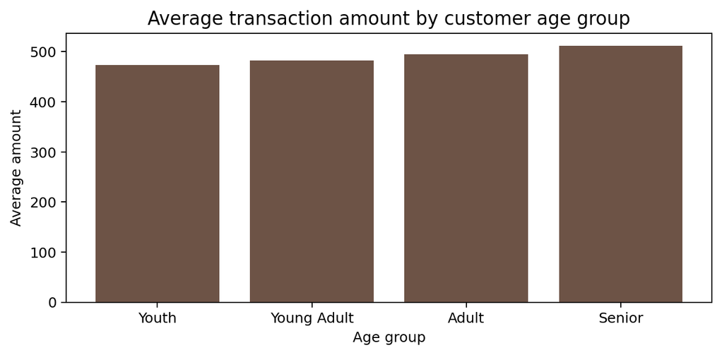
03 • RELATIONSHIPS
Demographics alone do not explain spending
Income-level averages are close: about 487–497.
Average amount rises across age groups: Youth 473.71 → Senior 511.37.
These are descriptive patterns, not proof that income or age causes spending differences.
FINMARK | MO-IT162 • MATH FOR MACHINE LEARNING: LINEAR ALGEBRA
10 | Speaker 3

Slide 11
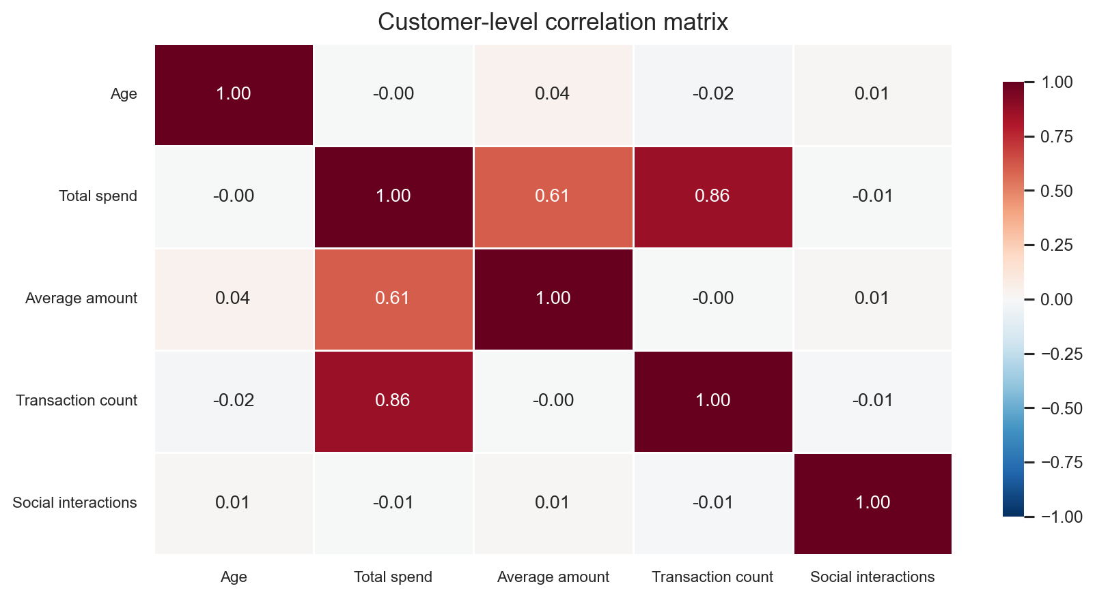
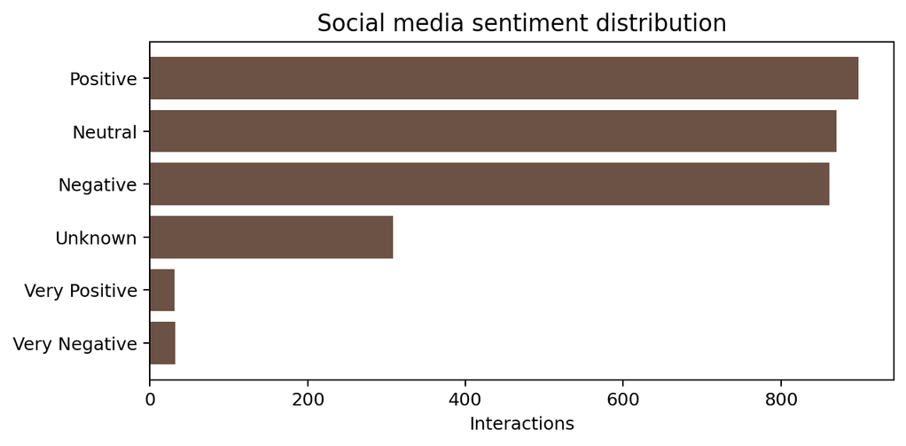
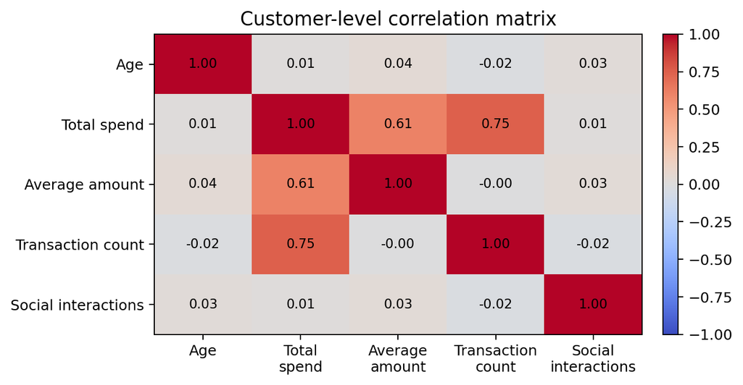
03 • CORRELATION & SOCIAL DATA
Customer-level relationships and engagement
Total spend ↔ transaction count: r = 0.863
Total spend ↔ average amount: r = 0.606
Positive, Neutral and Negative are the three largest sentiment groups; extreme sentiment labels are rare.
FINMARK | MO-IT162 • MATH FOR MACHINE LEARNING: LINEAR ALGEBRA
11 | Speaker 3

Slide 12
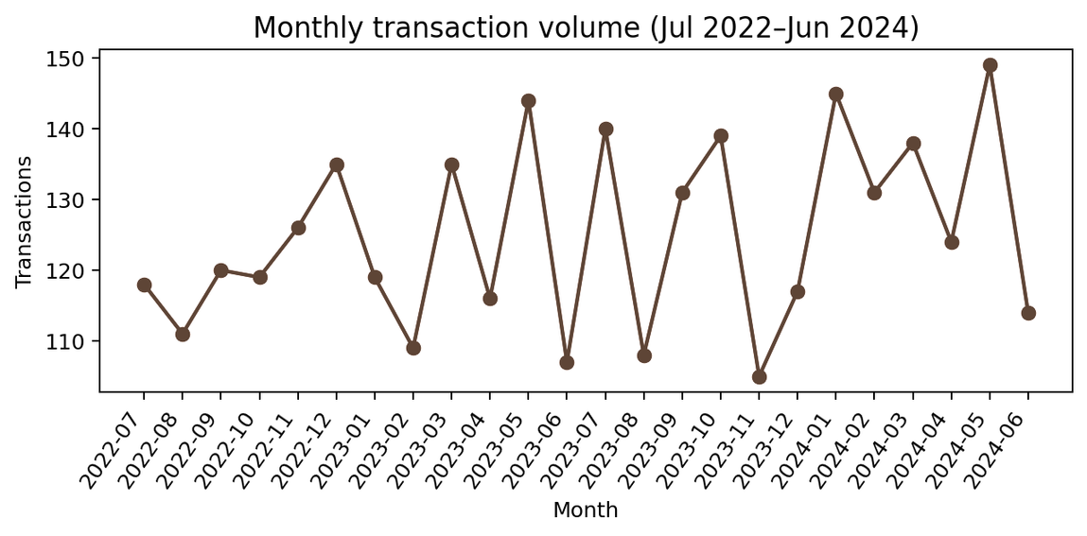
03 • TRENDS & ANOMALIES
Time trends and data-quality cautions
• Transaction volume peaked in May 2024 at 149 transactions.
• Average signed amount peaked in August 2023 at 548.843; social activity peaked in July 2023 at 270 interactions.
• The 1.5 × IQR screen found 0 age outliers and 0 transaction-amount outliers.
• Negative amounts, Free labels, and median-imputed values remain flagged for business review.
The 24-month window is too short to establish seasonality; unusual values still require business context.
FINMARK | MO-IT162 • MATH FOR MACHINE LEARNING: LINEAR ALGEBRA
12 | Speaker 3

Slide 13
03 • FEEDBACK & REPRODUCIBILITY
Professor feedback resolved
• Added source details, record counts, and explicit before/after cleaning evidence.
• Added descriptive statistics, category frequencies, correlations, outlier counts, and quantitative interpretations.
• Replaced unsupported duplicate-retention and transaction-value assumptions with auditable decisions.
• Aligned notebooks, datasets, evidence files, visualizations, and presentation values.
• Official source: sites.google.com/mmdc.mcl.edu.ph/finmarkcorp/home
One authoritative, reproducible submission is organized under Terminal_Assessment.
FINMARK | MO-IT162 • MATH FOR MACHINE LEARNING: LINEAR ALGEBRA
13 | All speakers

Slide 14
03 • CONCLUSION
What we learned and what comes next
• We transformed three contaminated datasets into consistent, deduplicated tables and documented special transaction cases.
• The customer base is centered around the mid-forties; income groups and product categories are broadly represented.
• Transaction frequency has the clearest positive relationship with total customer spending in the customer-level analysis.
• Age-group averages show a gradual increase, while income-group spending averages are very similar.
• Next: encode categorical variables, review Unknown and flagged transaction records, engineer customer-level features, then validate candidate models.
Our main takeaway: reliable machine learning starts with understanding the data, not simply feeding it into a model.
FINMARK | MO-IT162 • MATH FOR MACHINE LEARNING: LINEAR ALGEBRA
14 | Speaker 3

Slide 15

THANK
YOU
FINMARK | MO-IT162 • MATH FOR MACHINE LEARNING: LINEAR ALGEBRA
15 | All speakers

